Slide 1
Weekly Report
2017741025 장재우
2017741052 최석원
2016741012 문석준
2017741021 김태겸
Feb 24, 2022

Slide 2
Index
1
Project Concept
2
System Architecture
3
Progress
4
Schedule
5
KWIX

Slide 3
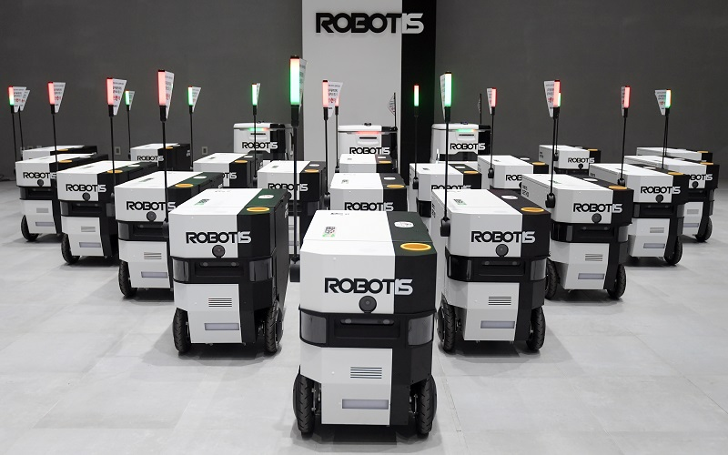
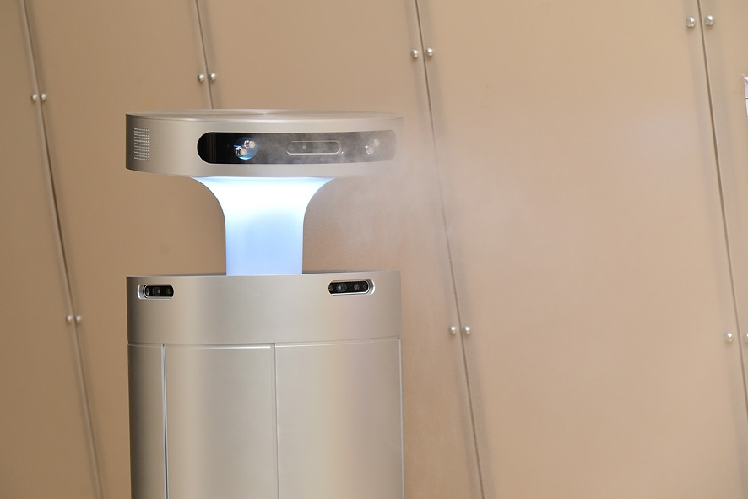
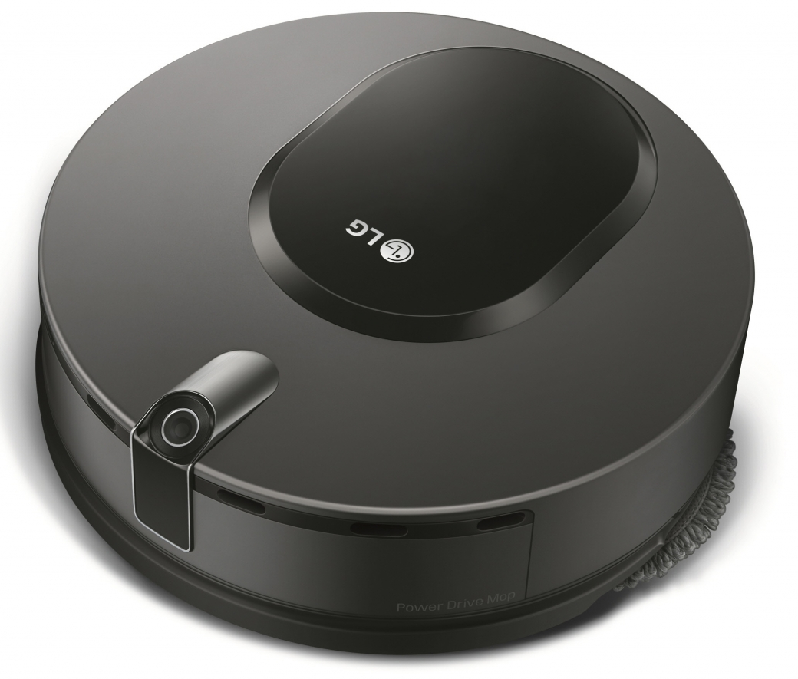
Project Concept
Problem about existing robots
One robot, one purpose
Fixed hardware, low adaptability

Slide 4
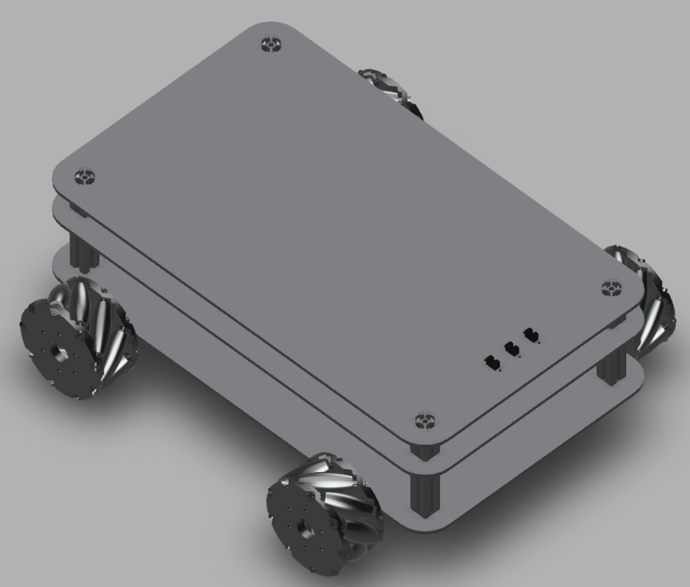
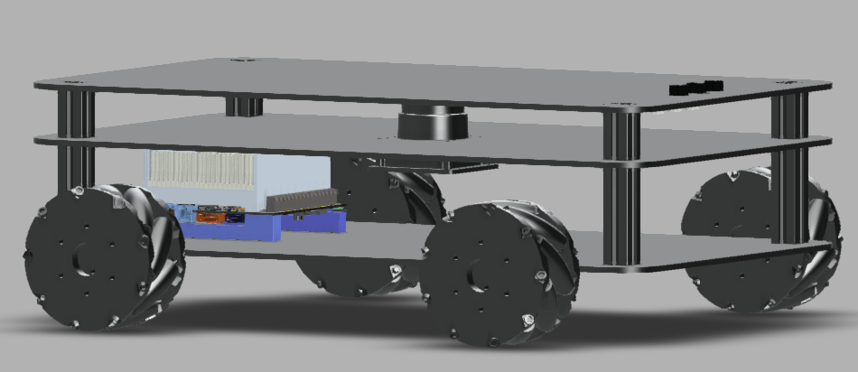
Project Concept
Proposal
One robot, many possibility
Changeable hardware, high adaptability
Robot platform + modules

Slide 5
Project Concept
Robot platform
Jetson AGX Xavier
Powerful GPU performance, fast computational processing power
LiDAR + Depth camera
SLAM & Detection based autonomous actions
Mecanum wheels
Move in all directions easily
Easy to connect modules
Use the limited switch to find out what module is connected
Power supply to the module using magnetic cable

Slide 6
Project Concept
Modules
Delivery
Get user input by GUI
Localization & navigation to the goal
Disinfection
Move around and detect door & doorknob
Spray disinfectant to doorknob
Cleaning
Global exploration based on wall following algorithm
Cleaning floor

Slide 7
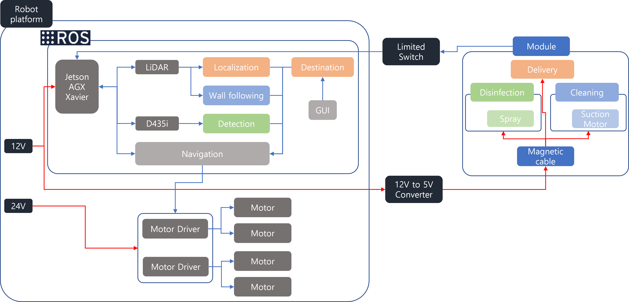
System Architecture

Slide 8
Progress
Hardware Design
Mecanum wheel kinematics
Detection using YOLOv5
Show bounding box on point cloud map

Slide 9
Progress
To do
Motor selection
Consideration about suspension
Case design
Module design
Consideration about motor controller
Find or make doorknob dataset

Slide 10
Schedule - HW

Slide 11
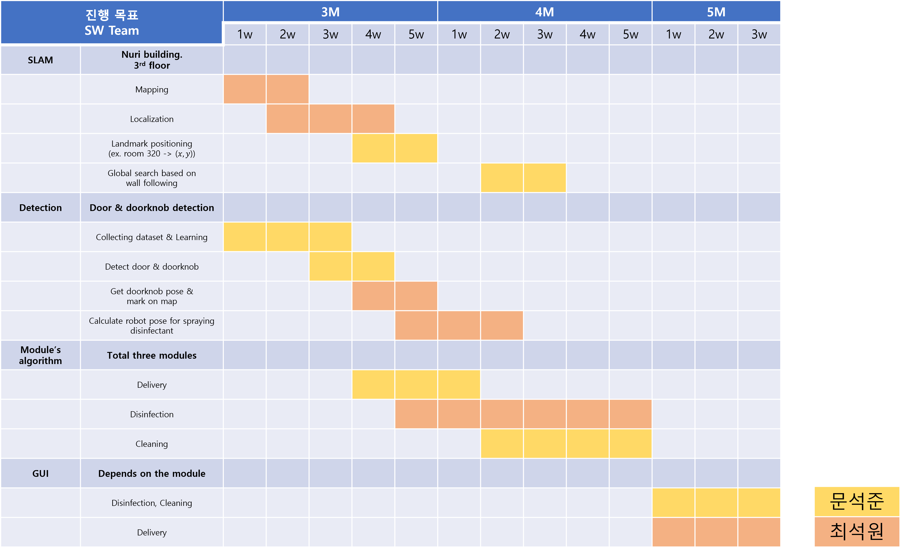
Schedule - SW

Slide 12
Q&A
Thank you

